Slide 1
Conditional Branching
How to manually control conditional branching from each slide

Slide 2
Introduction
On the next few slides, you’ll see questions which, when answered, can lead to alternative branching in your slideshow.
We call this Conditional Branching.
You can embed the hyperlink into any object on the slide, including the answer choices themselves.
Before you can click on the hyperlink and navigate, you have to let the software know that’s your intention (as opposed to regular navigation to the next slide) and press “H” on your keyboard.
Then you can click on the hyperlink.

Slide 3
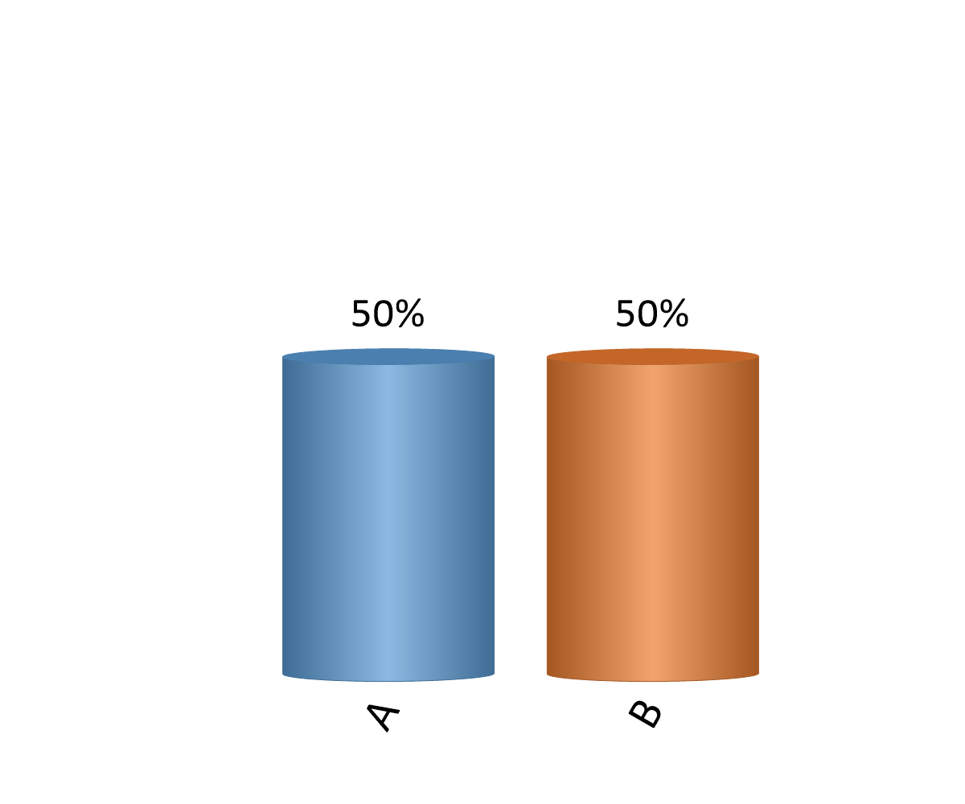
Do you drive a car?
Yes
No
Notes:
Conditional Branching notes – each link goes to a different slide.
Font has been colored black to hide the ‘clicked’ state of the link and to unify the design.

Slide 4
Is it new or pre-owned?
New
Pre-owned
Notes:
Each link takes you to a different slide.
Font has been colored black to hide the ‘clicked’ state of the link and to unify the design.

Slide 5
Do you own it or lease it?
Own
Lease
Notes:
Slide Name : Standard Question Slide
Font has been colored black to hide the ‘clicked’ state of the link and to unify the design.

Slide 6
Hey, walking and taking public transport is healthy and responsible

Slide 7
Congratulations Car Owner

Slide 8
There’s nothing wrong with leasing

Slide 9
Let’s hope the previous owner took care of your new ride

